Slide 1

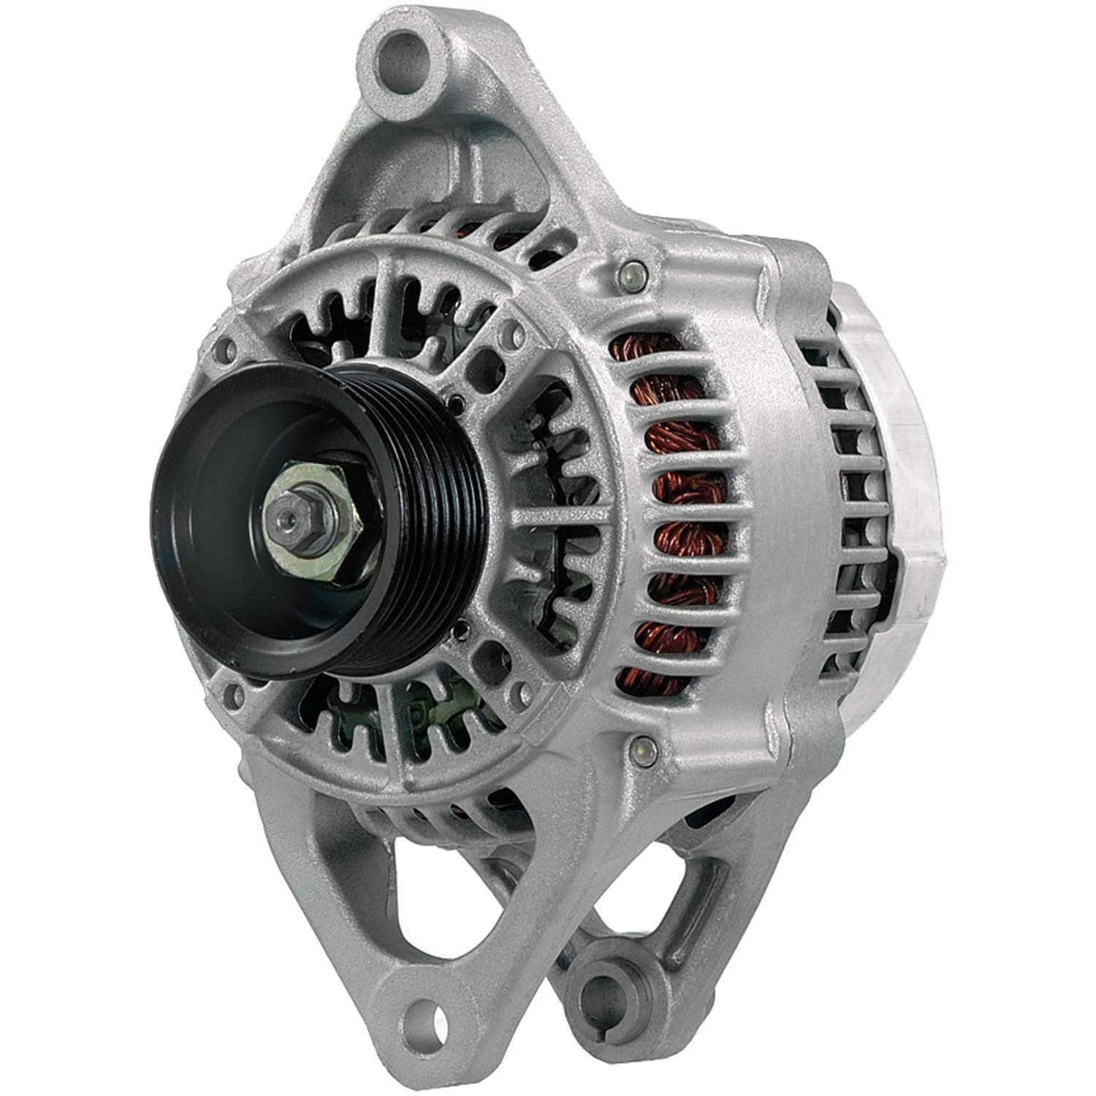
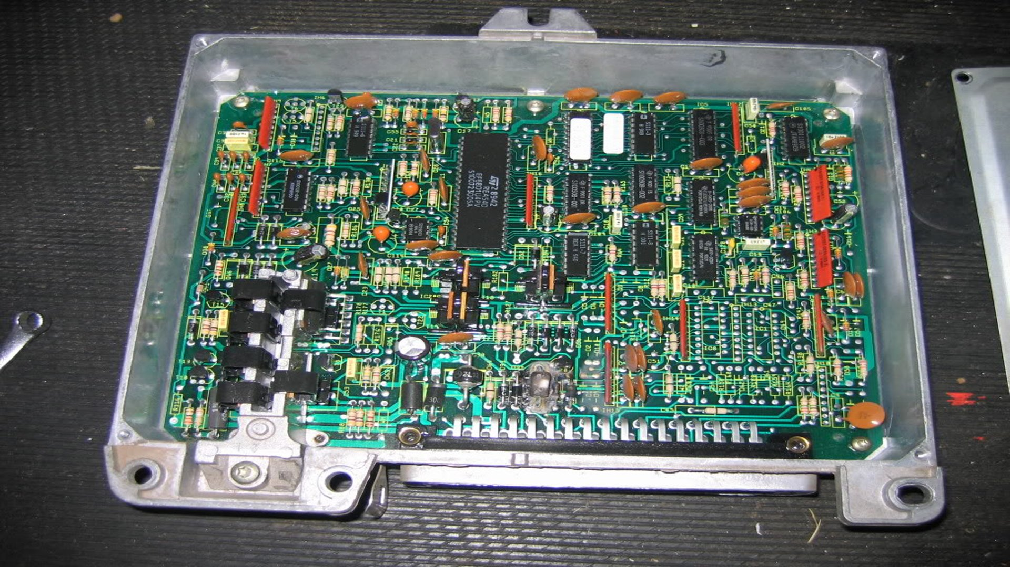
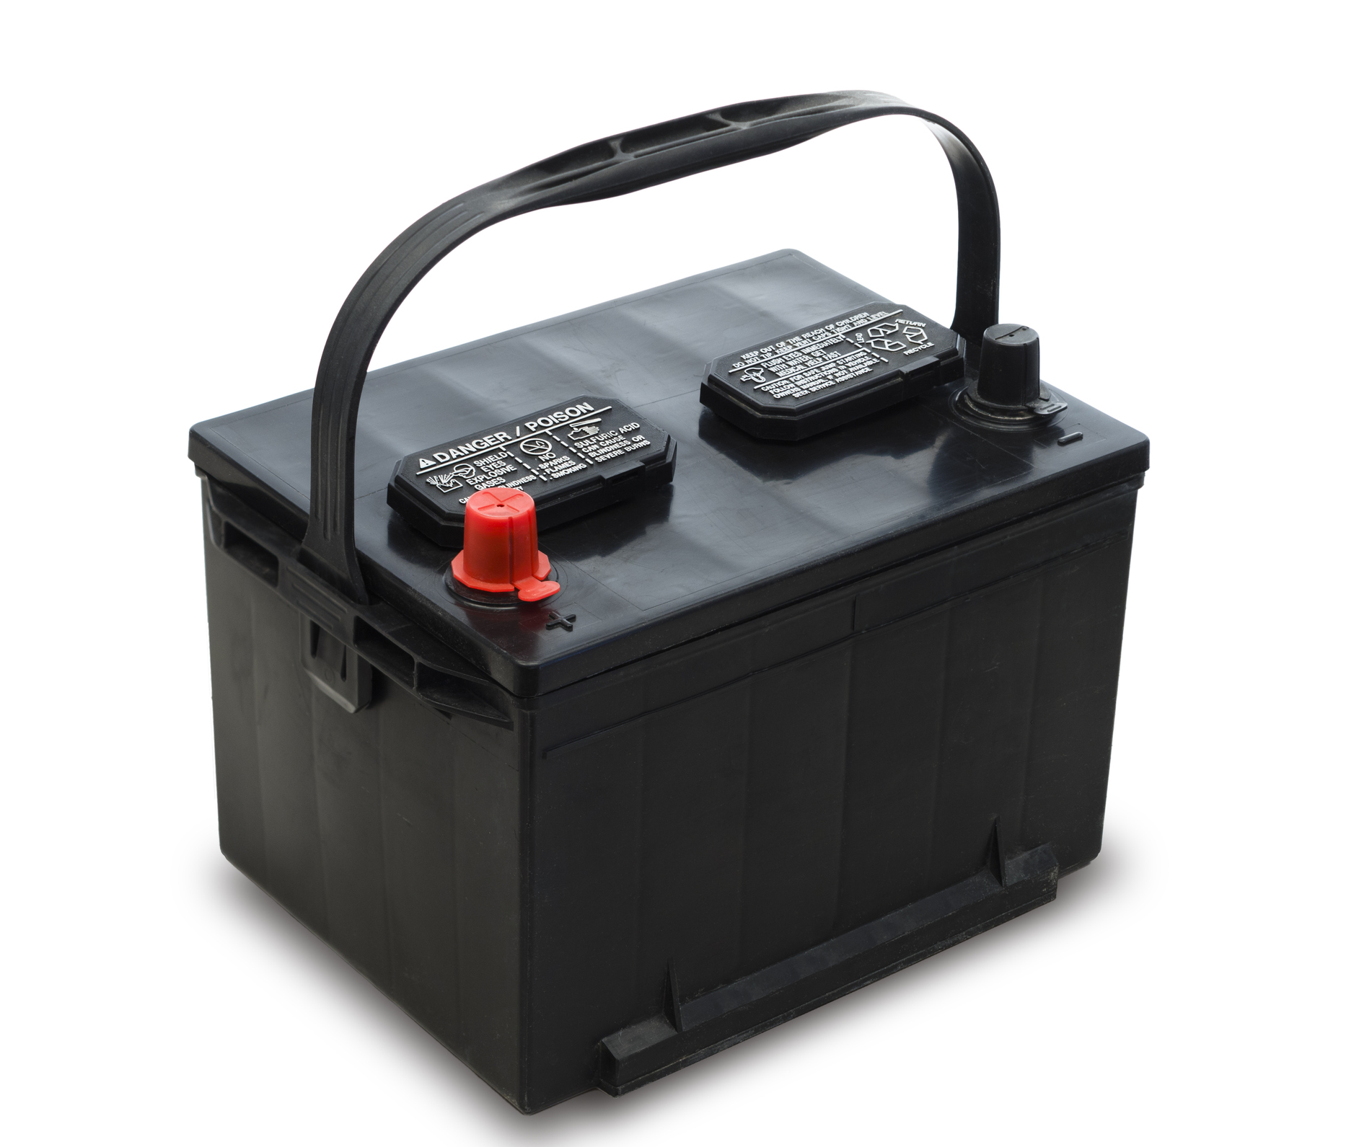
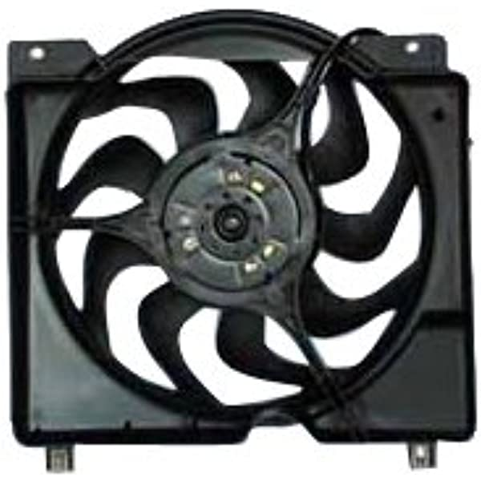




Jeep Cherokee XJ
Description of system:
The Jeep Cherokee XJ is a "sport utility vehicle" with many mechanical, electrical, computer controlled systems. The XJ is designed for general transportation of people and cargo as well as adventures of off-roading and overlanding.
Mechanical Systems:
Alternator
Power source:
Chemical energy
Output power:
3Ph AC
Engine Steering Brakes Gears Transmission | Pumps Barings Fluids Hoses Belts
A/C Compressor
Alternator
Control Systems:
Diodes and voltage regulator
Converts it to 12Vdc
150Amps – 1800W
2.4HP
Electrical System:
ECM
Fuel Injector Anti-lock Brakes Cruise Control
ECM
12Vdc
~16Amps
Wires
Battery
Temp sensor
Radiator Fan
Battery
12Vdc
~150Amps
Radiator Fan
12Vdc
~60Amps
~3500RPM
A Mechatronic System

